Slide 1
Introduction to WoT

Slide 2
Internet of Things (1)
A network of physical devices embedded with sensors, actuators, software and connectivity that enable real objects to collect data and act on the environment
These devices provides automation, monitoring, and control
IoT applications span various domains
smart homes, healthcare, transportation, industrial automation, enhancing efficiency and enabling real-time decision-making
Key statistics:
Number devices, as of 2023, there are approximately 16.7 billion IoT devices worldwide, which is more than twice the number of people on Earth. This number is expected to grow to over 27 billion by 2025
Market Growth, the global IoT market was valued at $662.21 billion in 2023 and is projected to reach around $3.3 trillion by 2030
Smart Home Devices, in 2022, 857 million smart home devices were shipped globally. This number is expected to increase to 1.09 billion by 2027

Slide 3
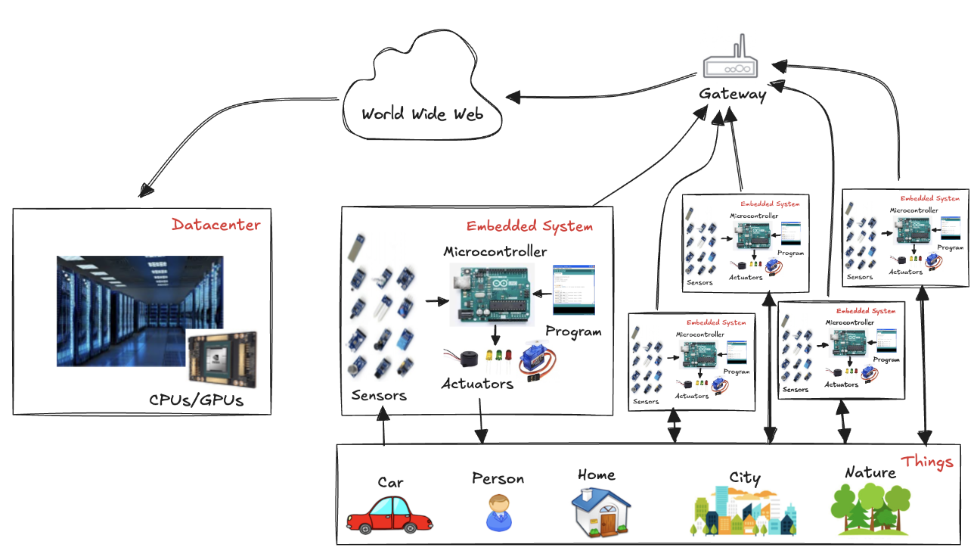
Internet of Things (2)

Slide 4
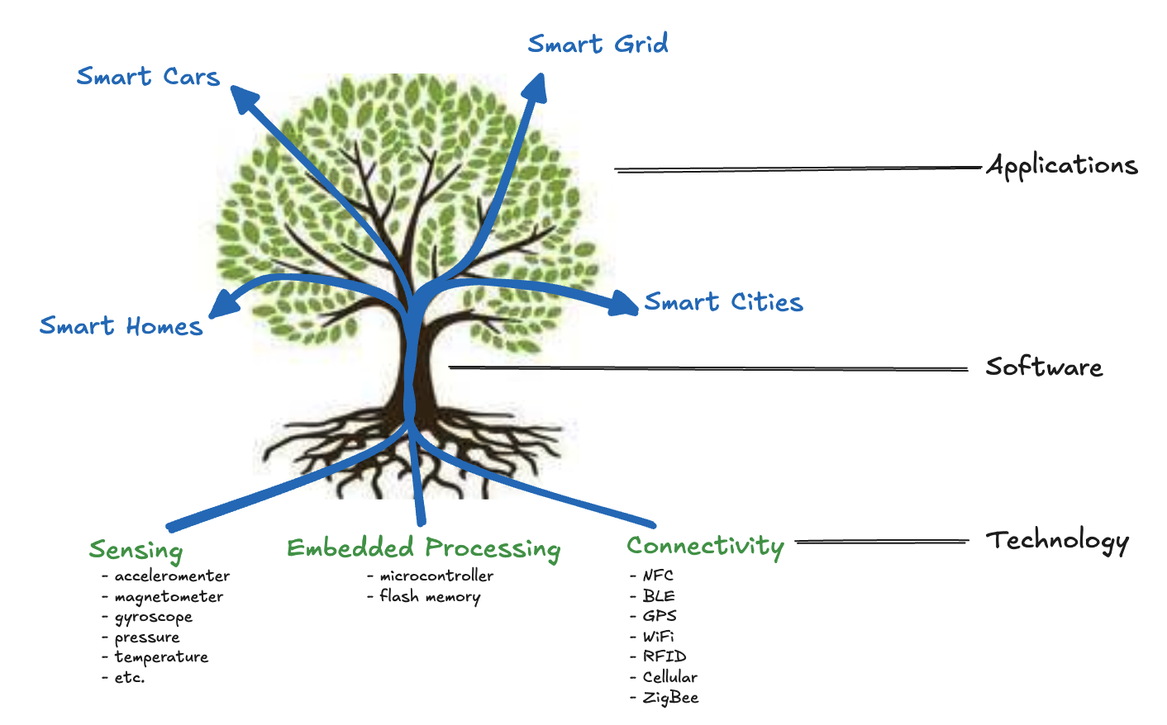
Technologies, Software, Services

Slide 5
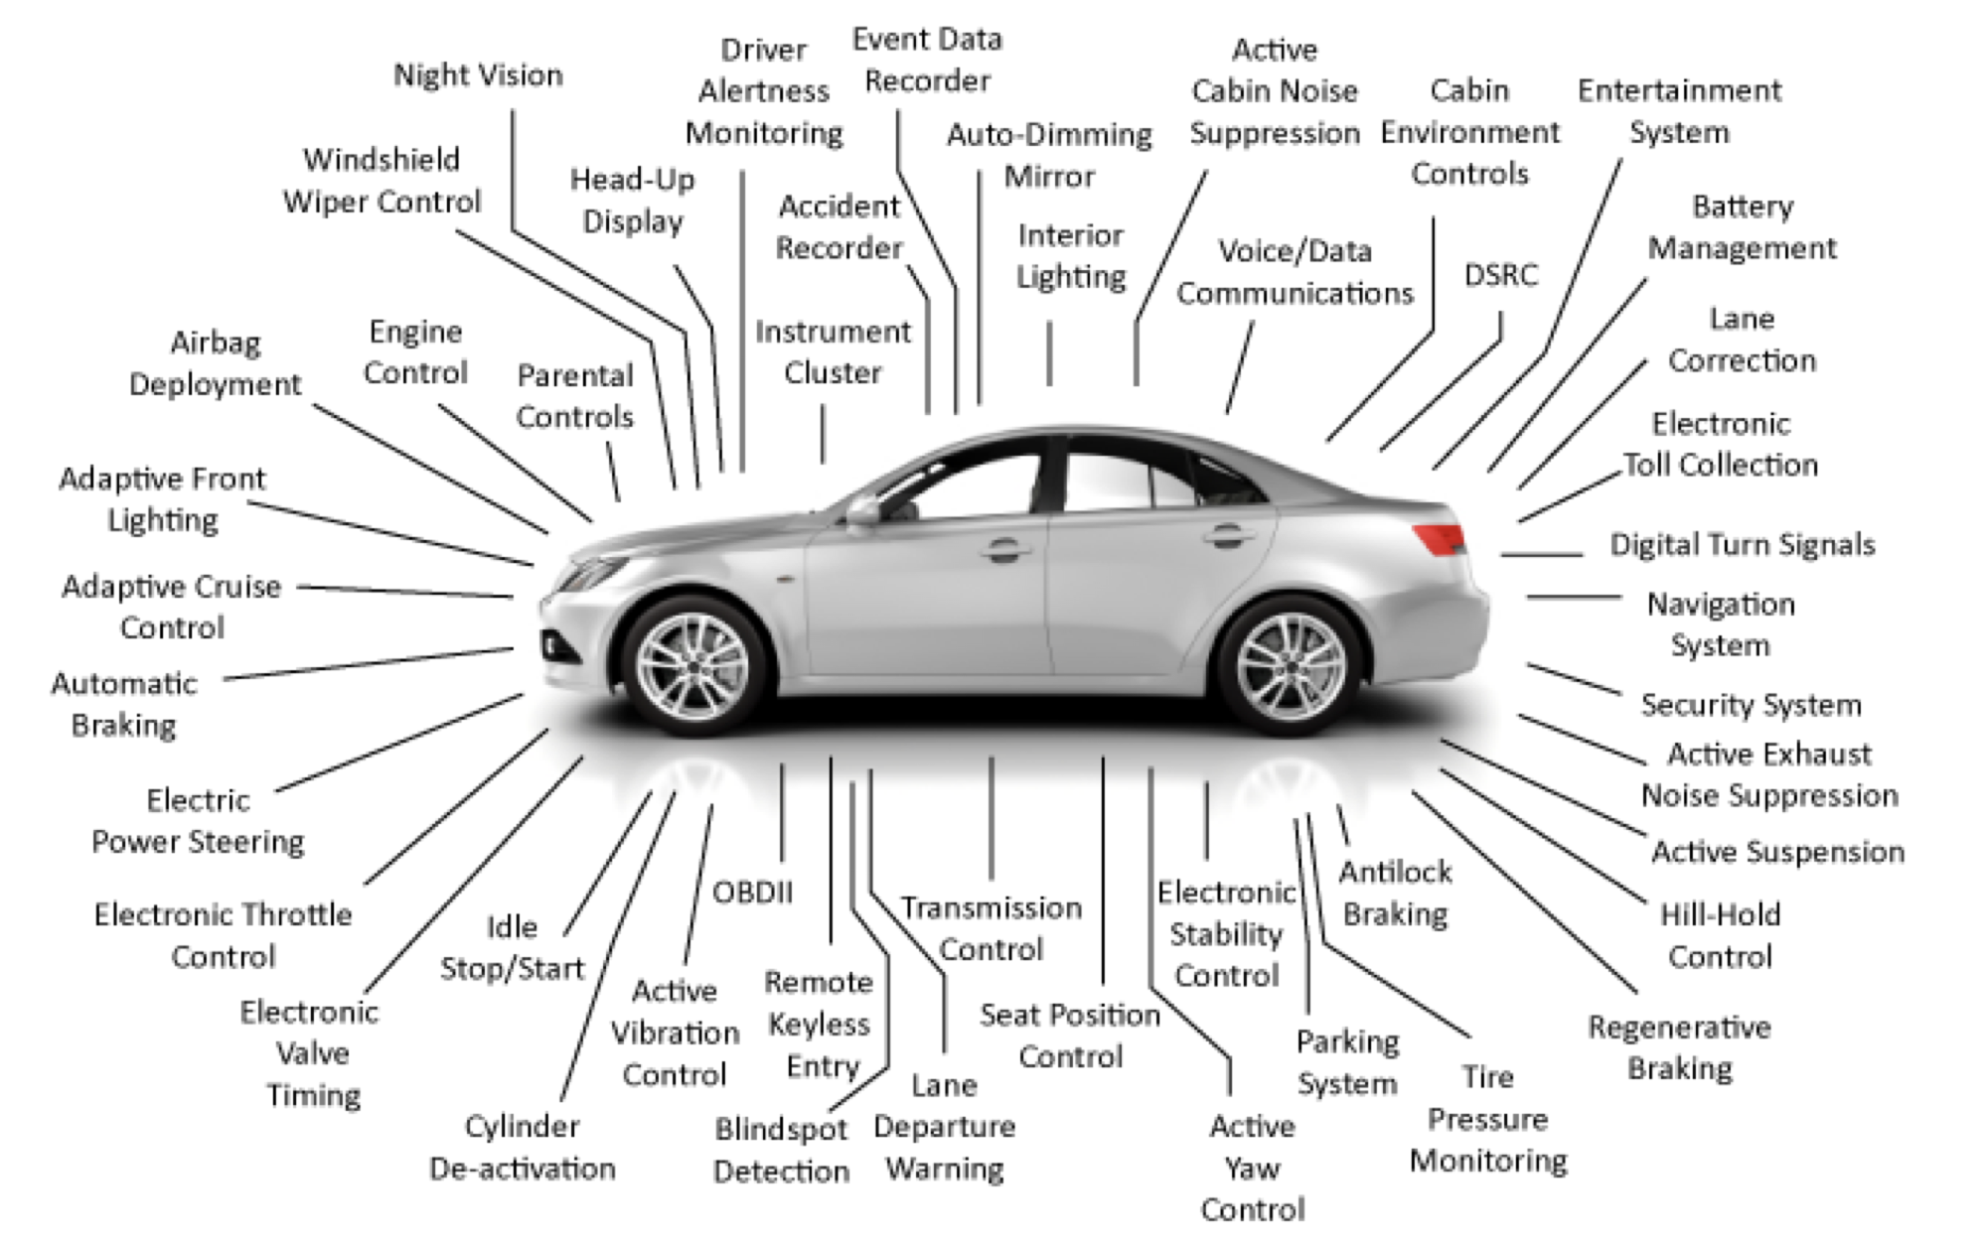
Smart car scenario

Slide 6
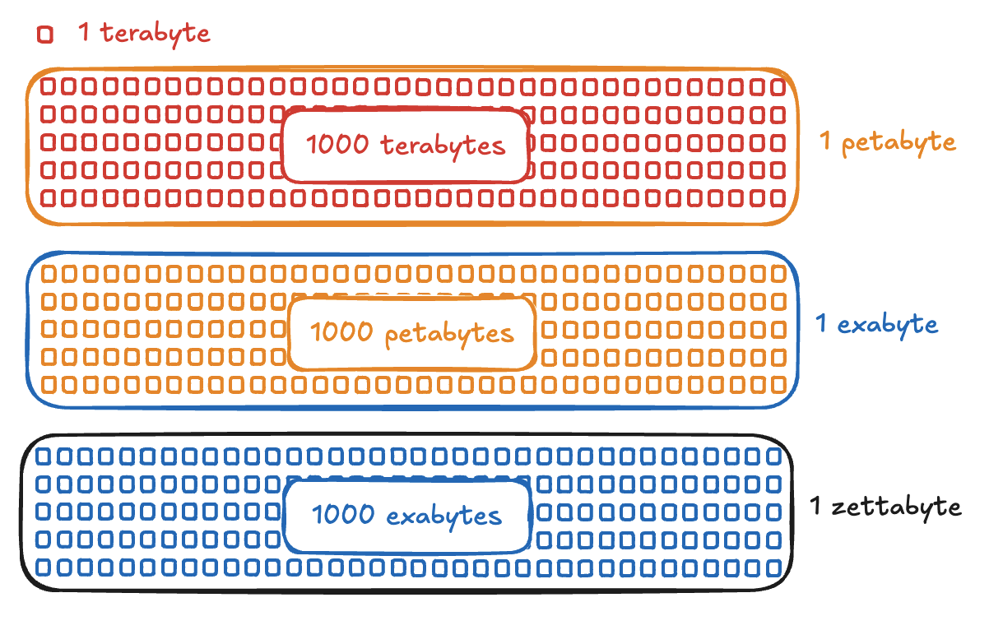
Problem: big data!
The amount of data generated by IoT devices is expected to reach 73.1 zettabytes (ZB) by 2025!

Slide 7
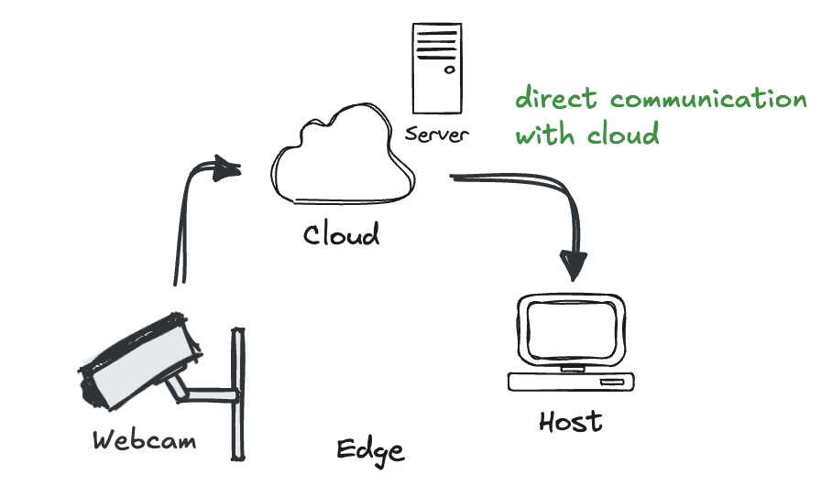
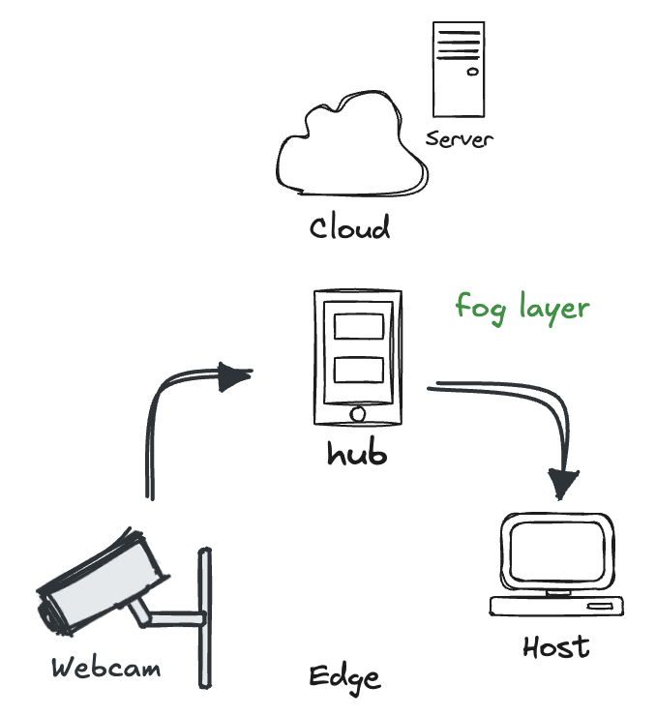
Fog Computing
Cloud computing refers to the delivery of computing services (storage, servers, databases, software, and more) over the internet. Instead of owning and maintaining physical infrastructure, it is possible to use services on-demand and pay for only what it is used
The growth in IoT is unsustainable under this architectural approach: latency, network bandwidth, reliability and security cannot be addressed in cloud-only models
Fog computing is a distributed computing paradigm that extends cloud computing to the edge of the network, closer to the data sources. It aims to reduce latency and network congestion by processing data locally, in nearby edge devices or fog nodes, rather than transmitting it to a remote cloud.

Slide 8
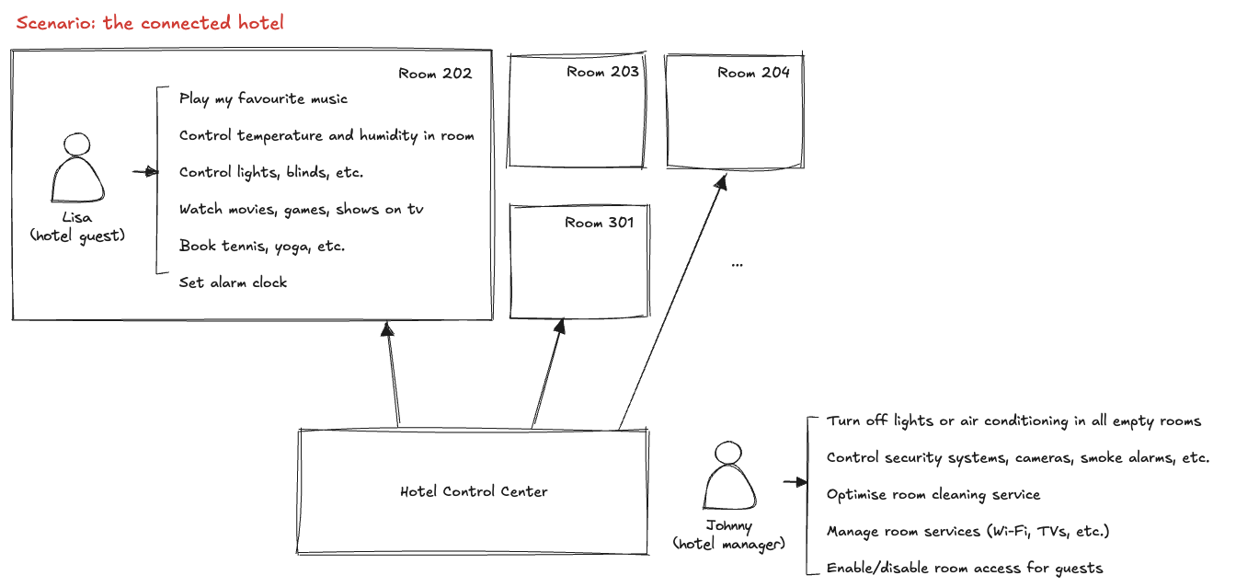
Scenario: Connected Hotel

Slide 9
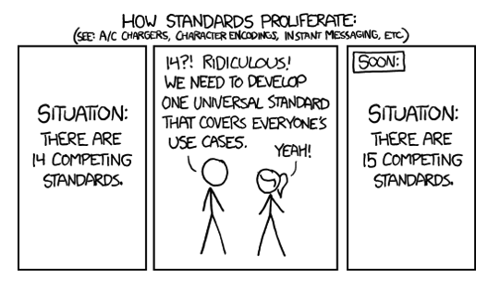
Problem: standards proliferation
Standard proliferation in IoT arises from the existence of numerous, often incompatible standards developed by different organizations and industries
This lack of uniformity hinders interoperability between devices, complicates integration, and slows down the adoption of IoT solutions on a global scale
But pay attention at the solution:

Slide 10
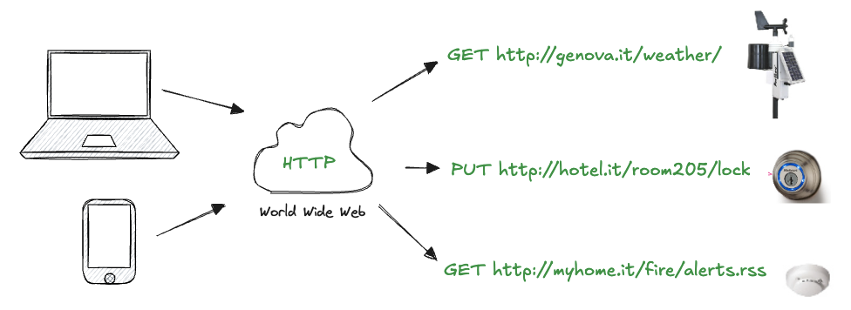
Web of Things (WoT)
WoT focuses on reusing web standards to enable seamless interaction and interoperability among connected devices
By employing technologies like HTTP, RESTful APIs, JSON, and semantic data models, the WoT abstracts the complexity of IoT systems, making devices accessible and controllable as web resources
This approach simplifies integration, fosters scalability, and enhances the usability of IoT ecosystems

Slide 11
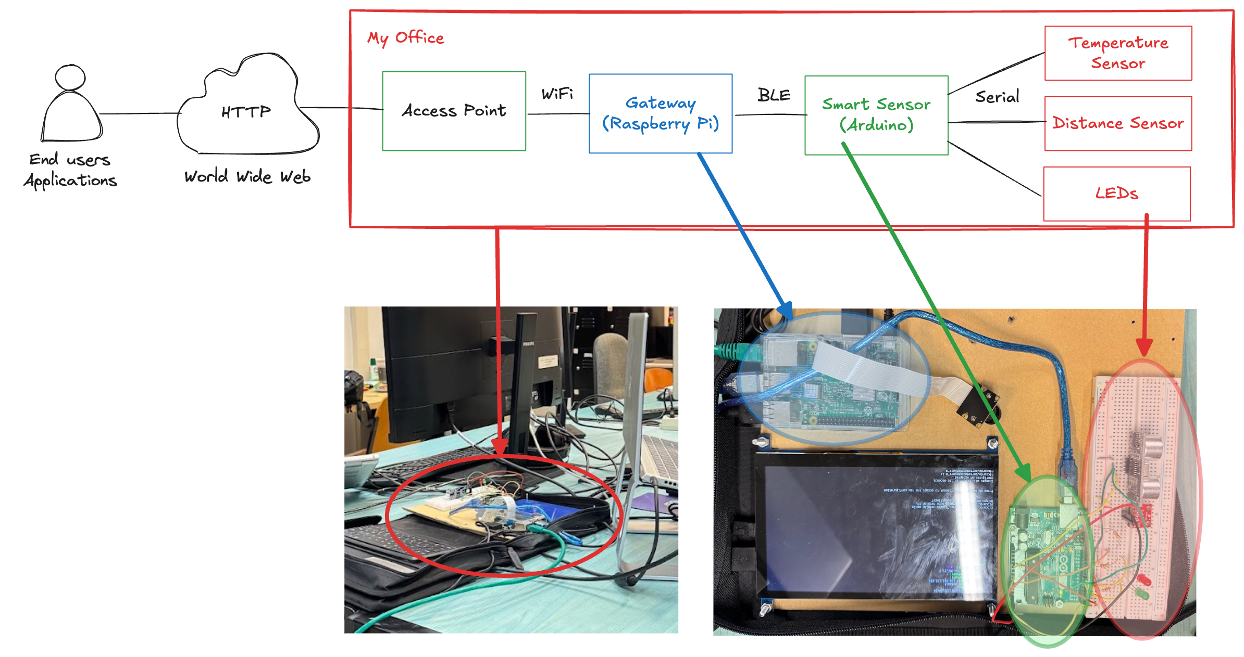
An end-to-end example
Consider an IoT system called "My Office" where a gateway aggregates data from multiple sensors and transmits it to the cloud via an access point, allowing end-users and applications to access and control the system seamlessly:

Slide 12
The Web as a GUI
We can interact with the WoT from the browser, just like we browse the various pages of a Web site:
https://makers.diten.unige.it/iot
https://makers.diten.unige.it/iot/sensors/camera
Humans can explore the various content offered by a device and control it from a Web page (and URLs)
sensors, actuators
Notice the URL path structure
the URL is the root page of the gateway
information about the gateway itself
the list of devices attached to it
The page is automatically generated based on what physical devices are attached to it
it looks just like any other Web page
it is actually real data served in real time from real devices

Slide 13
The Web as an API
What if instead of a human user, we are a software application? How to make easy for any web client to find a device, understand what it does, what its services look like, what commands it can send, and so on?
We need an API (Application Programming Interface): a set of rules and tools to allow applications to communicate and interact
get a list of devices:
GET https://makers.diten.unige.it/iot/sensors/ [header, accept=application/json]
get a single device:
GET https://makers.diten.unige.it/iot/sensors/temperature [header, accept=application/jason]
Web browsers are for humans, we need a different tool: Postman allows to send HTTP requests and to customize options (headers and payload)
Applications need machine-readable formats
JSON: the most successful data interchange format used on the Internet
easy to understand syntax
lightweight (efficient to transmit)
easy for humans to read and write
easy for machines to parse and generate

Slide 14
A GUI for the WoT
Every element of the device is simply a resource with a unique URL that can be used both by people and applications to read and write data
Now, we put the developer hat on and start building an application that interacts with the WoT device
Code: 01.polling-sensor.html
Code: 02.polling-sensor-chart.html
Polling a sensor worked just fine, but this seems somewhat inefficient: instead of having to fetch the temperature from the device every few seconds, wouldn’t it be better if our code was informed of any change of temperature only when they happen (and if they happen)?
One of the major impedance mismatches between the model of the Web and the event driven model of IoT applications
Solution: WebSockets
Code: 03.websockets-temp-graph.html

Slide 15
Act on the real world
We have seen various ways to read sensor data, what about “writing” to a device? For example, we would like to send a command to our device
A simple HTML form that sends a POST command to the URL a led
Code: 04.actuator-form.html
The method works well, unfortunately the browsers do not submit a JSON payload body, but use a format called "application/x-www-form-urlencoded", because of some legacy reasons
We can write a function which takes the data from the form, packs it into a JSON object, POSTs it to the Pi and displays the result if successful
Code: 05.actuator-ajax-json.html

Slide 16
Semantic gap
We assumed to know what the fields of the JSON objects (e.g. sensor or actuator) mean and how to use them. What if the only thing we know about a device is its URL and nothing else?
First, we need to find the devices at a network level
device discovery problem
how can applications discover the root URL all the devices?
Second, our application should “understand” what sensors/actuators the device offers, what formats it use, and what is the meaning of properties, fields, and so on
semantic gap
A (partial) solution: exploit the other feature of the web, links

Slide 17
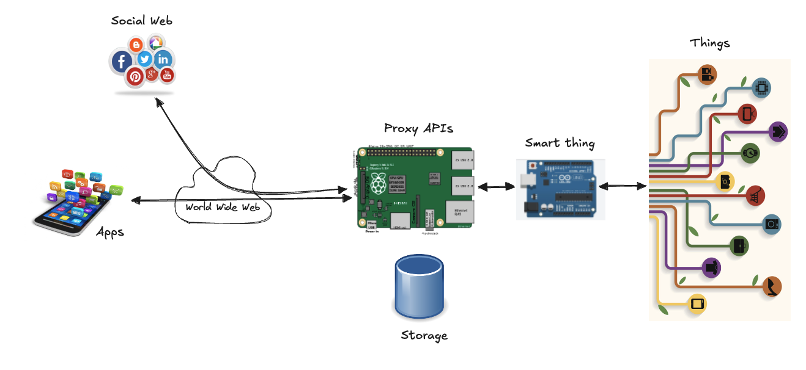
Landscape

Slide 18
Reflect
We communicate with an embedded device, potentially connected at the other end of the world (my office) with a Web page
We fetch, on a regular basis, data from a sensor connected to the device and display it on a graph: not bad for a simple web page of some lines of HTML and JavaScript code
Let’s imagine for a second our Pi wasn’t actually providing its data through HTTP, JSON and WebSockets, but through a IoT machine-to-machine application stack (such as ZigBee or similar): we would have no chances of talking directly to the device from a browser, we would have been forced to write our application using a lower-level language (such as C or Java), we would not have been able to use widespread concepts and languages (such as URLs, HTML, CSS and JavaScript)
This is what the WoT is about: creating API for things that are universally accessible and bringing them closer the masses of Web development where a lot of today’s innovation and creative building happens.

Slide 19
Hands-on Activity
Play around with the different URLs you can find at http://devices.webofthings.io using Postman. Look at how they differ and are structured, browse around the device and try to understand what data each sensor has, their format, etc.
Look at the electronic devices around you (the appliances in your kitchen or the TV or sound system in your living room, the ordering system in the café, the train notification system, etc). Now imagine how the services and data offered by all these devices could all have a similar structure: URLs, content, paths. Try to map this system using the same JSON structure we have seen and write the URLs and JSON object that would be returned.

